Slide 1


CSCI-6221
Julia Group Presentation
Alan(Changjia) Yang
Yvonne(Youwen) Liu
Robert(Bo) Liu
Waad Algorashy
Tiffany Nguyen

Slide 2

Why are we interested in Julia?
Parametric polymorphism
Multiple dispatch
Concurrent computing
Direct calling of C and Fortran libraries
JIT compilation

Slide 3




Evaluation Criteria
Community
Package Ecosystem
Learning Materials
Employability
Programming Paradigms
Performance
Concurrency

Slide 4

Community
The Julia community has a presence across multiple platforms such as GitHub Twitter, LinkedIn, Facebook ..etc.
Notes:
Julia is a dynamic programming language which provides high-level programming flexibility and performance comparable to that of compiled languages such as C. Join the conversation with #JuliaLang. See less
Julia is a high-level dynamic programming language for high-performance numerical and scientific computing.

Slide 5
Community
Measured by:
● # projects actively developed in total on GitHub
● # Conferences in history
● # Hacker News Posts in total
● “Programming, scripting, and markup languages” question of Stack Overflow survey
● “Most Loved” question of Stack Overflow survey
● “Top Paying Technology” question of Stack Overflow survey
Note: The results of “Most Loved” question , “Programming, scripting, and markup languages” question and “Top Paying Technology” question of Stack Overflow survey is based on 2021 survey results. The result of “Top Paying Technology” is median number of salary.
Notes:
Julia is a dynamic programming language which provides high-level programming flexibility and performance comparable to that of compiled languages such as C. Join the conversation with #JuliaLang. See less
Julia is a high-level dynamic programming language for high-performance numerical and scientific computing.

Slide 6
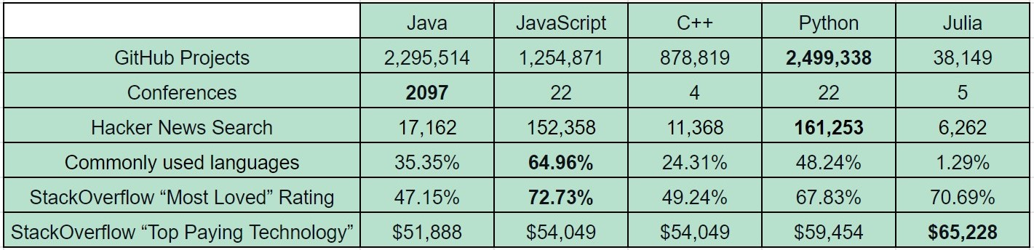
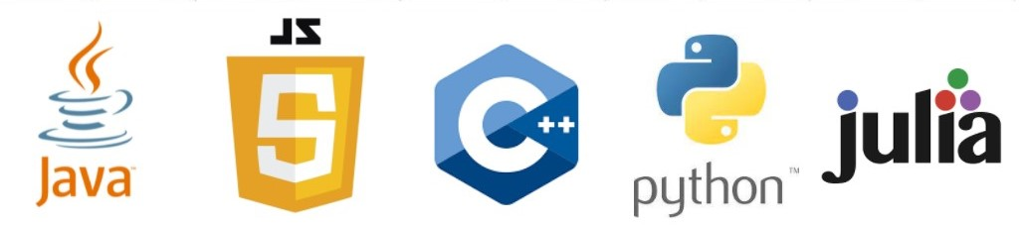
Community
Notes:
Julia is a dynamic programming language which provides high-level programming flexibility and performance comparable to that of compiled languages such as C. Join the conversation with #JuliaLang. See less
Julia is a high-level dynamic programming language for high-performance numerical and scientific computing.

Slide 7
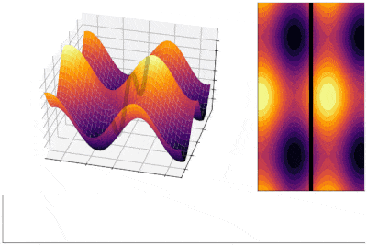
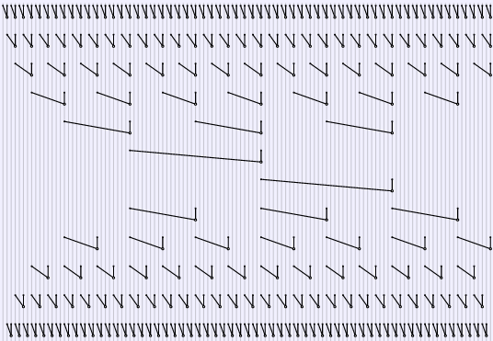
Package Ecosystem
Visualization:
Data Visualization and Plotting
Plots.jl
Parallel Computing:
Parallel and Heterogeneous Computing,

Slide 8
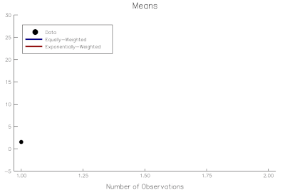
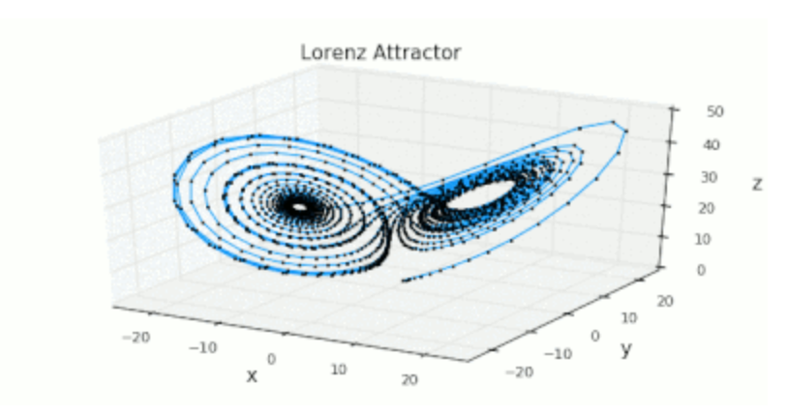
Package Ecosystem
Scientific domain:
Scientific Computing,DifferentialEquations.jl
Data science:
Interact with your Data,DataFrames.jl

Slide 9
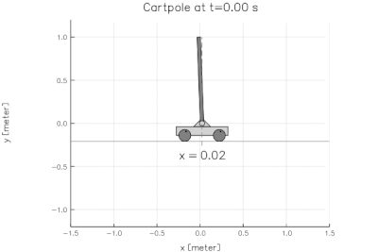
Package Ecosystem
Machine learning :
Scalable Machine Learning ;
MLJ.jl package, which include generalized linear models, decision trees, and clustering.
Flux.jl and Knet.jl packages for Deep Learning.

Slide 10
Learning Materials
Online projects:
Ex: Github, Stackflow
Books.
Official documents
Ex: julialang.org
Online video tutorials
Ex: Youtube
Online courses:
Ex: Udemy

Slide 11
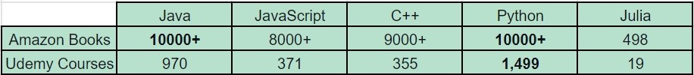
Learning Materials
Note: Amazon book store does not show the specific number over 1000 results

Slide 12
Employability
Data Analyst & Data scientist :
Advanced understanding of a statistical programming language such as R, Python, or Julia.
Systems Programmer
Julia Computing.

Slide 13



Employability
Measured by number of impressions of “xxx developer” on popular job sites located in United States:
● Indeed
● ZipRecruiter
● LinkedIn

Slide 14
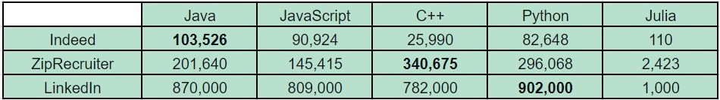
Employability
Note: Statistics collected on April 8, 2022

Slide 15
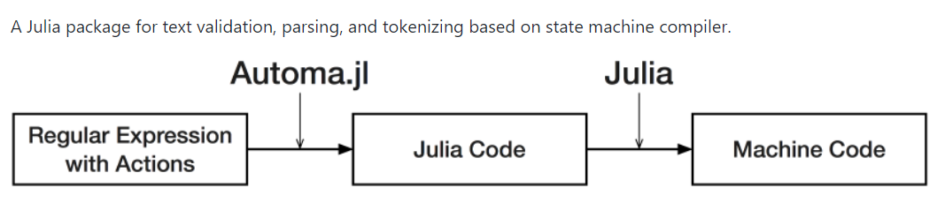
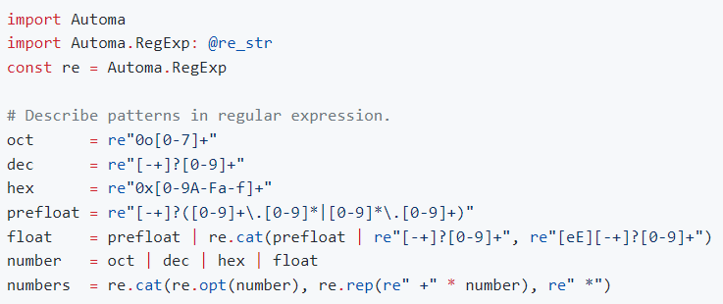
Programming Paradigms 1
Packages and resources that support various programming styles, Software Architecture and CS paradigms.
Automata
Control Flow
Declarative Programming
Functional Programming
DSL
Grammatical Evolution
Interpreters
Language Comparison
Macro
Metaprogramming
Automatic Programming
Multi Threading
Polymorphism
Double Dispatch
Multiple Dispatch
Program Analysis
Reactive Programming
STATIC ANALYSIS
Turnaround Time
Style Guidelines
Examples:
Automa.jl :: A julia code generator for regular expressions - this package can do text validation, parsing, and tokenizing based on a state machine compiler.
A tokenizer of octal, decimal, hexadecimal and floating point numbers

Slide 16
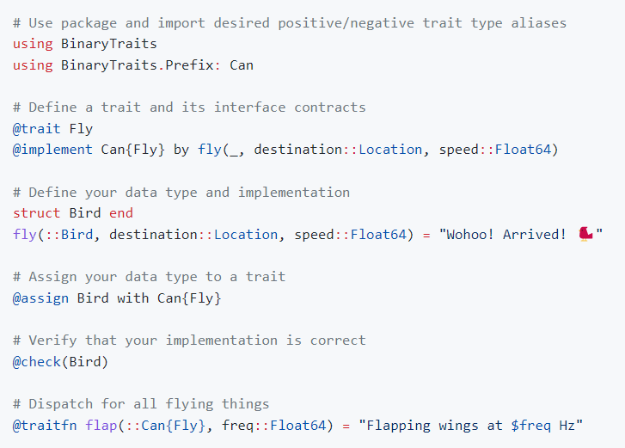
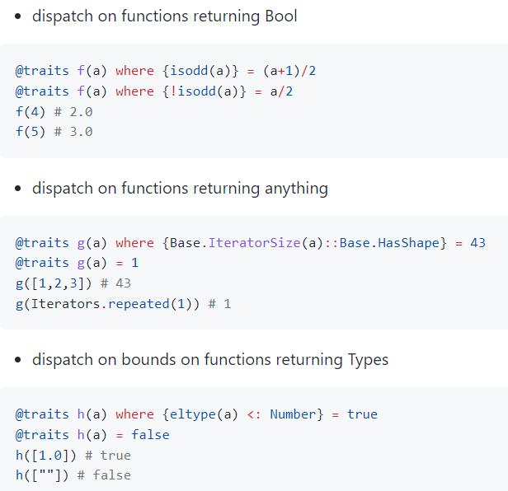
Programming Paradigms 2
Julia uses multiple dispatch as a paradigm, making it easy to express many object-oriented and functional programming patterns.
Examples:
BinaryTraits.jl :: easy-to-use trait library with formal interface specification support.
WhereTraits.jl :: This package exports one powerful macro @traits with which you can extend Julia's where syntax.

Slide 17
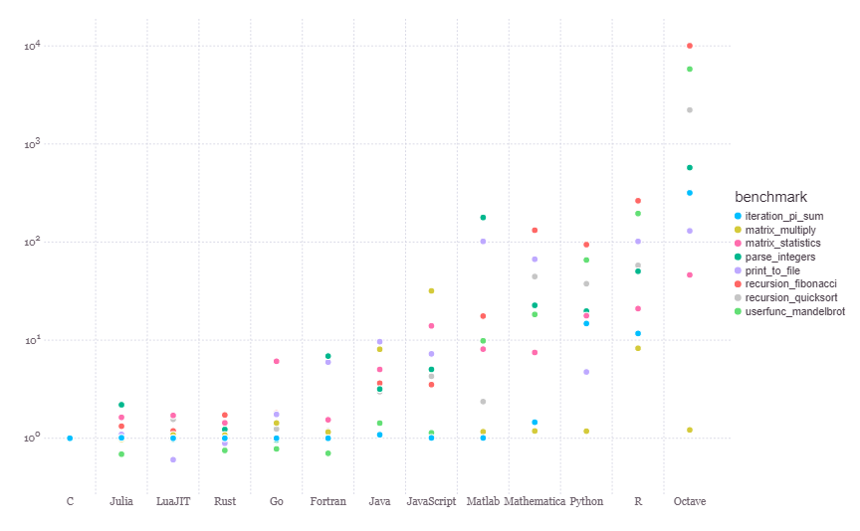
Performance
Julia Micro-Benchmarks

Slide 18
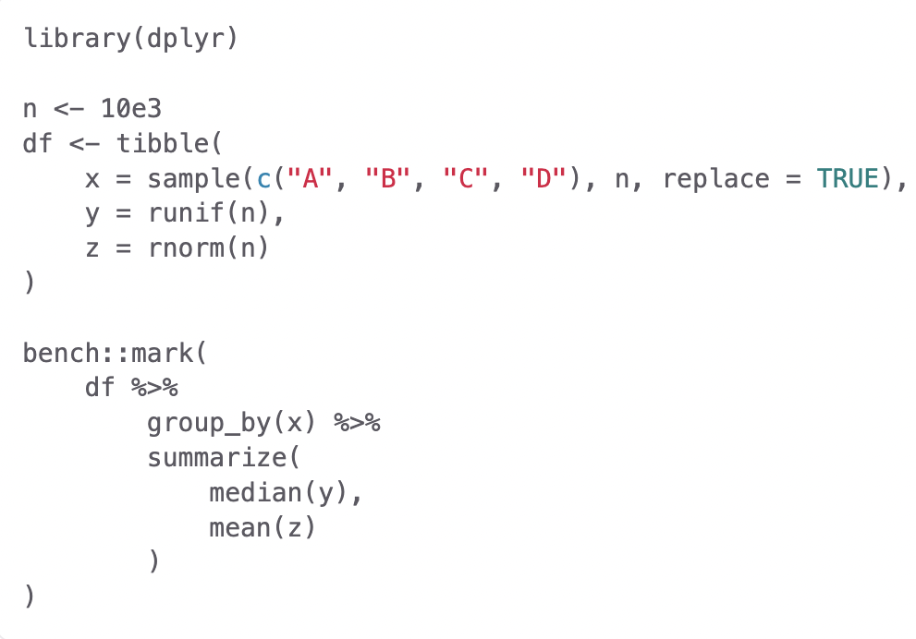

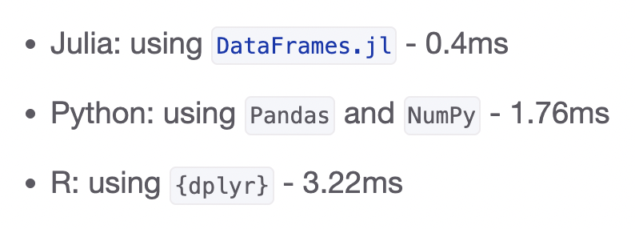
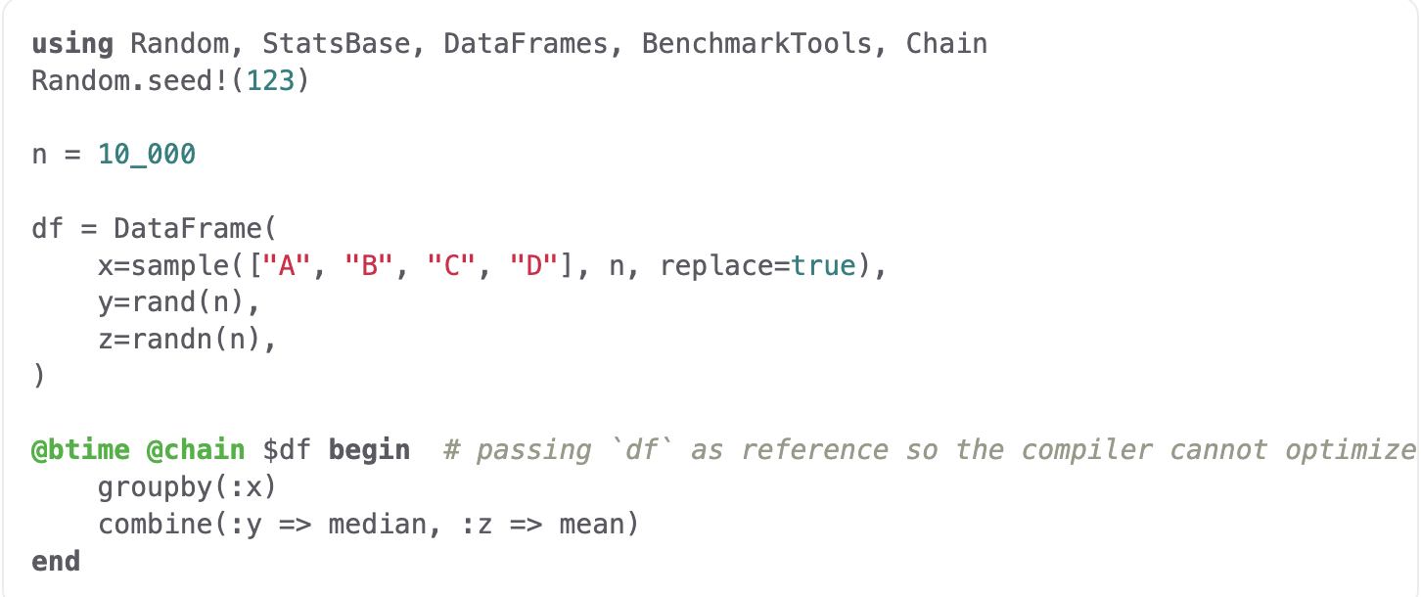
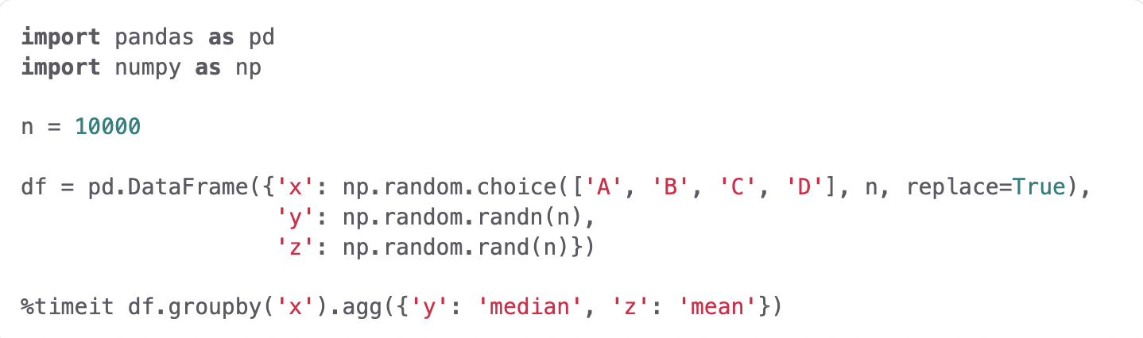
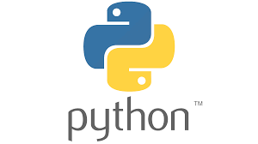

Performance

Slide 19
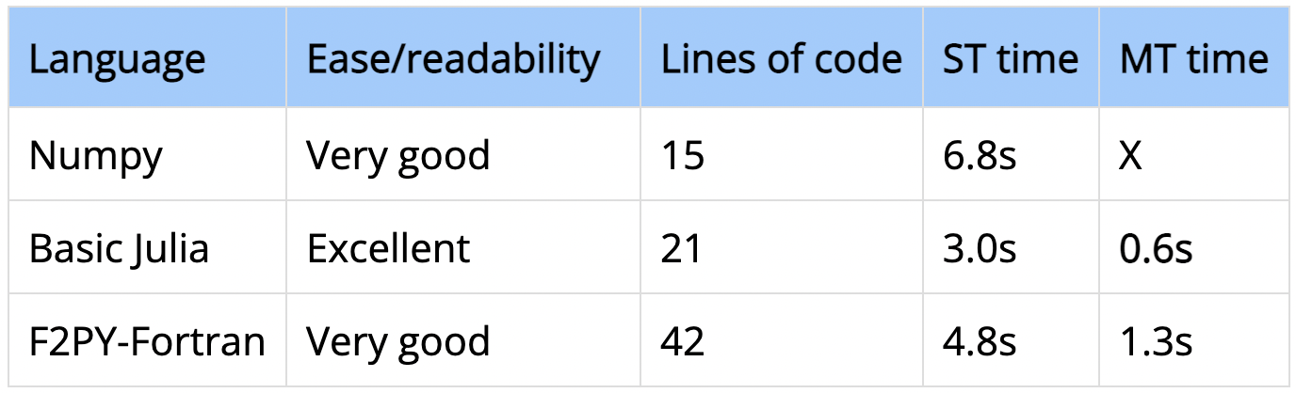
Performance

Slide 20
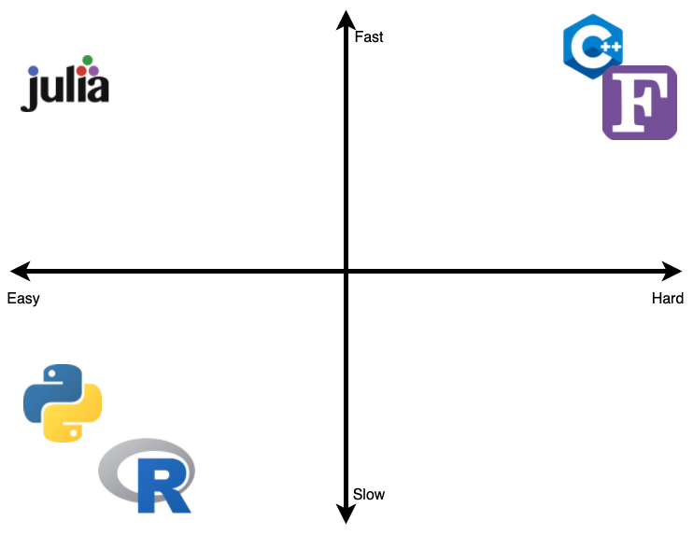
Performance
If you want to…
code fast and easy
…use

Slide 21
Concurrency
Concurrency means the ability for a program to be decomposed into parts that can be run independently.
Julia supports a variety of styles of concurrent computation.
A multithreaded computation(simultaneous work)
Distributed computing
GPU computing

Slide 22


LIVE DEMO
We will run everything through Jupyter Notebook.

Slide 23
Any Questions?
More details can be found through our Github link: https://github.com/yliu1268/CSCI6221-Group-Project-Julia

Slide 24
Thank you for your time!

